Slide 1
An Algorithmic Framework for Chemically Stable DNA Data Storage: Minimizing Data Loss using XOR-Based Data Whitening and Dynamic Error Correction
Md. Mubarak Hossain Razwan
ID : 02423100005101027
And
Md. Sazzadul Islam Shaon
ID : 02423100005101028
Department of CSE
Daffodil International University

Slide 2
Outline
Introduction
Background Study/Literature Review
Gap Analysis
Objective
Motivation
Novelty of this Study
Datasets, Tools and Techniques
Proposed Methodology
Expected Outcomes
Q & A

Slide 3
Introduction
The Problem: The world is creating data way too fast—we hit 221 Zettabytes in 2026, and traditional hard drives and silicon chips simply can't keep up.
The Solution: Synthetic DNA can store massive amounts of data in tiny spaces for thousands of years with almost no maintenance.
The Catch: Converting digital 0s and 1s into DNA letters {A, C, G, T} needs a reliable software pipeline so nothing gets scrambled.
Built a working parser that converts .TXT and .PDF files into DNA code and back without losing data.
Developed a Dynamic Programming alignment module to test accuracy and pinpoint any exact data loss.

Slide 4
Background Study/Literature Review
Tech Giants are Moving to DNA: Companies like Microsoft and researchers worldwide are actively testing DNA for long-term data archiving.
How the Translation Works: It’s simple in theory—we map binary pairs to the four DNA letters:
00 A (Adenine)
01 C (Cytosine)
10 G (Guanine)
11 T (Thymine)
The Major Bottleneck: Biological storage is extremely noisy. When you synthesize or sequence real DNA, you get mutations like missing bases, extra bases, or swapped letters.
Existing Fixes: Researchers use mathematical Error Correction Codes (like Reed-Solomon, HEDGES, or Deep Learning) to recover lost data.

Slide 5
Gap Analysis
Direct Encoding Is Unsafe: Simply mapping 0s and 1s straight into DNA sequences sounds easy, but it creates major physical chemistry problems in a laboratory setting.
Chemical Instability Risks: Direct conversion causes long runs of identical bases (homopolymers) and severe GC-content imbalance. Both make DNA synthesis fail or mutate heavily.
Current Software Ignores Physical Limits: Existing baseline algorithms often overlook these chemical constraints entirely during the initial encoding phase.
How Our Project Fills the Gap:
We built a universal Encoder/Decoder pipeline and a Dynamic Programming accuracy tester in Phase 1 to establish a stable digital baseline.
This baseline is required before we can safely apply chemical filtering (XOR whitening) and Error Correction Codes (ECC) in the next phases.

Slide 6
Objective
Universal Parser (Phase 1): Design a lossless Encoder/Decoder pipeline to convert .TXT and .PDF files into binary and DNA sequences, then restore them completely.
DP Accuracy Tester (Phase 1): Build a Dynamic Programming alignment module to precisely measure precision, error rates, and data loss.
XOR Data Whitening (Phase 2): Implement XOR masking algorithms to keep GC-content stable between 40–60% and prevent chemical failure.
Compression & ECC (Phase 2): Apply Huffman Coding for sequence compression and integrated Error Correction Codes (Reed-Solomon) to prevent biological data loss.

Slide 7
Motivation
Silicon Limits: Traditional storage media cannot sustain the world's 221 Zettabyte data explosion and ~50% annual growth.
Massive Density: Synthetic DNA packs enormous volumes of digital data into microscopic samples lasting thousands of years.
Software Need: Biological channels are noisy; robust software is needed to make digital-to-DNA translation stable and accurate.
Sustainability: Replaces energy-intensive server farms with low-energy biological archiving.

Slide 8
Novelty of this Study
Universal Lossless Parser: Unlike basic models, our Phase 1 engine seamlessly converts complex .PDF structures alongside .TXT files without metadata loss or format corruption.
Dynamic Programming Accuracy Tester: Uses Levenshtein sequence alignment to detect exact character-level loss, errors, and mutations directly within the software pipeline.
Pre-Synthesis Chemical Balancing (Upcoming): Solves wet-lab failures by introducing an XOR-based data whitening algorithm to maintain a stable 40–60% GC-content.
100% In-Silico Pipeline: Eliminates costly wet-lab experiments by fully simulating biological noise, error rates, and sequence reconstruction computationally.

Slide 9
Datasets, Tools and Techniques
Benchmark Datasets (Corpus): Sample electronic .TXT and .PDF documents used to test full computational reconstruction.
Core Software Tools: Built in Python 3 using Google Colaboratory as the primary development environment.
Key Python Libraries:
PyPDF2 — Custom parsing to extract pure, raw text content from complex PDF structures.
Matplotlib — Generating real-time telemetry graphs for precision and error density monitoring.
difflib — Supporting exact sequence matching and sequence alignment operations..

Slide 10
Algorithmic Techniques:
Binary & DNA Encoding/Decoding: Translating text to ASCII, 8-bit binary, and mapping pairs directly to biological bases {A, C, G, T}.
Dynamic Programming: Sequence alignment (Levenshtein Edit Distance) to mathematically evaluate accuracy, true positives, and exact character loss

Slide 11
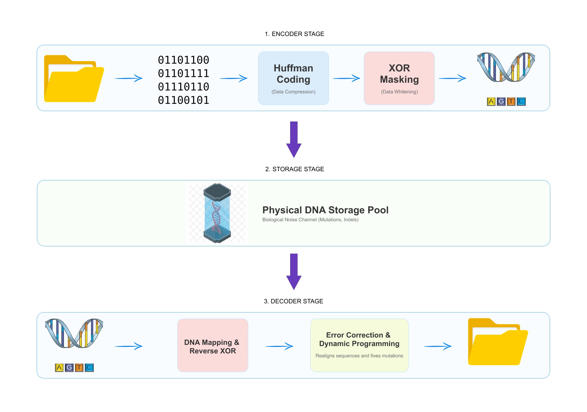
Proposed Methodology

Slide 12
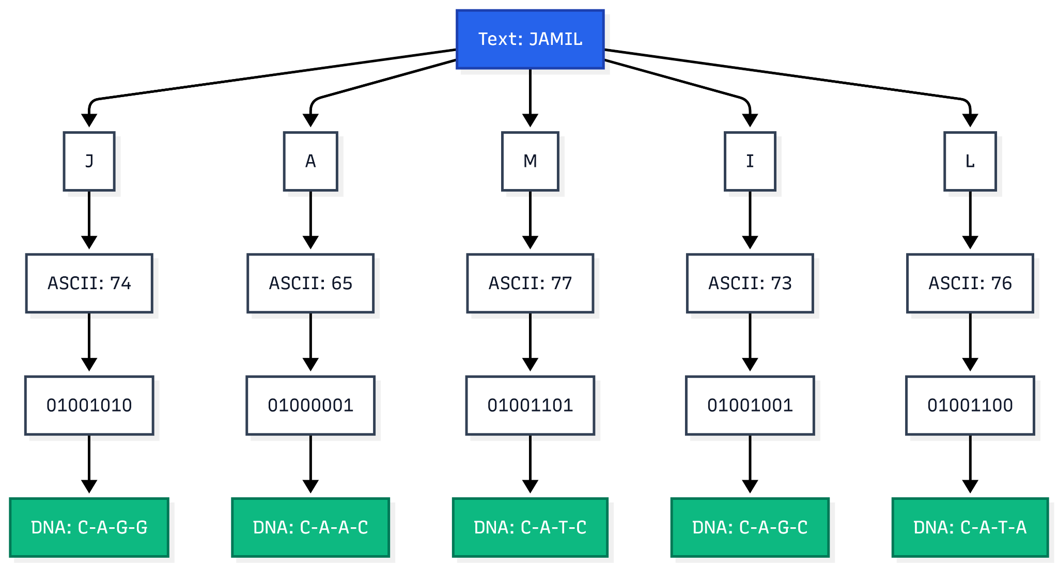

Slide 13
Expected Outcomes
Lossless File Recovery: Achieve 100% data reconstruction precision (0% error rate) across both simple .TXT and complex .PDF file formats.
Chemically Stable DNA Sequences: Lock GC-content strictly within the safe 40–60% range and eliminate homopolymer runs via XOR data whitening.
Biological Noise Resilience: Maintain accurate sequence decoding even under simulated synthetic insertion, deletion, and substitution mutations.
Quantifiable Pipeline Benchmarks: Deliver real-time visual telemetry, alignment matrices, and precision logs through the Dynamic Programming testing framework.

Slide 14
THANK YOU

